Slide 1
CS 2001 Data Structures
Week 2
Lecture 1

Slide 2
Agenda
Exception Handling for Arrays - making it safe.
Lower and Upper Bounds errors/ detail error handling and reporting
Solving problems- using DynamicSafeArray
consider an example of finding a duplicate in an unsorted array etc. (would be covered in Lab)

Slide 3
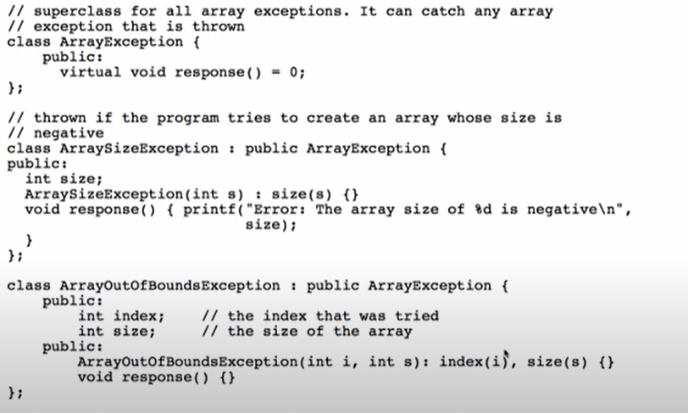

Slide 4
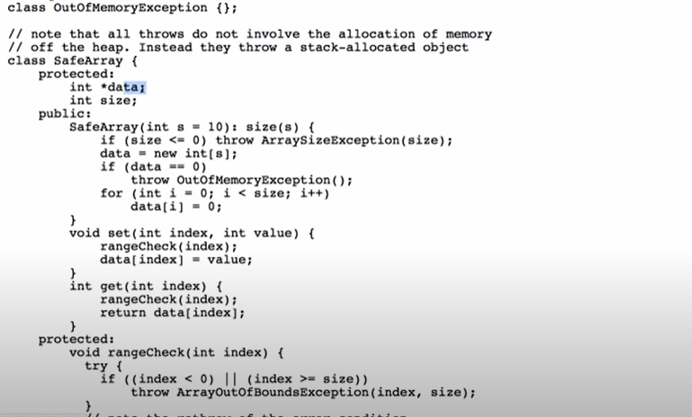

Slide 5
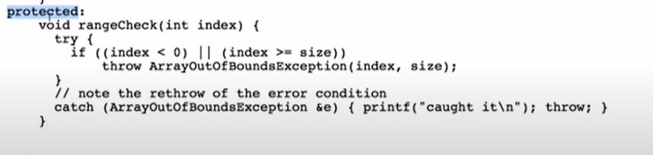

Slide 6
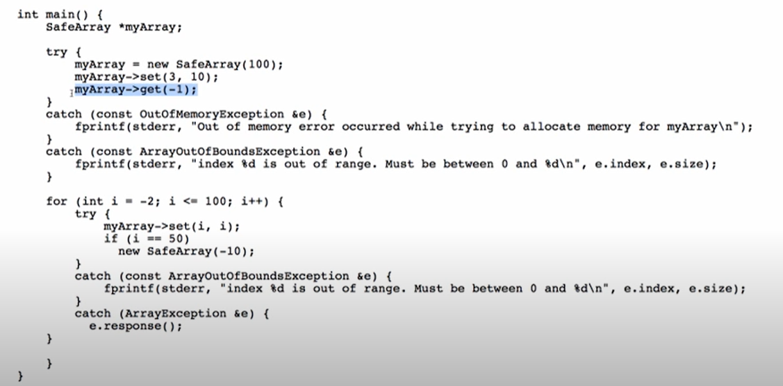

Slide 7
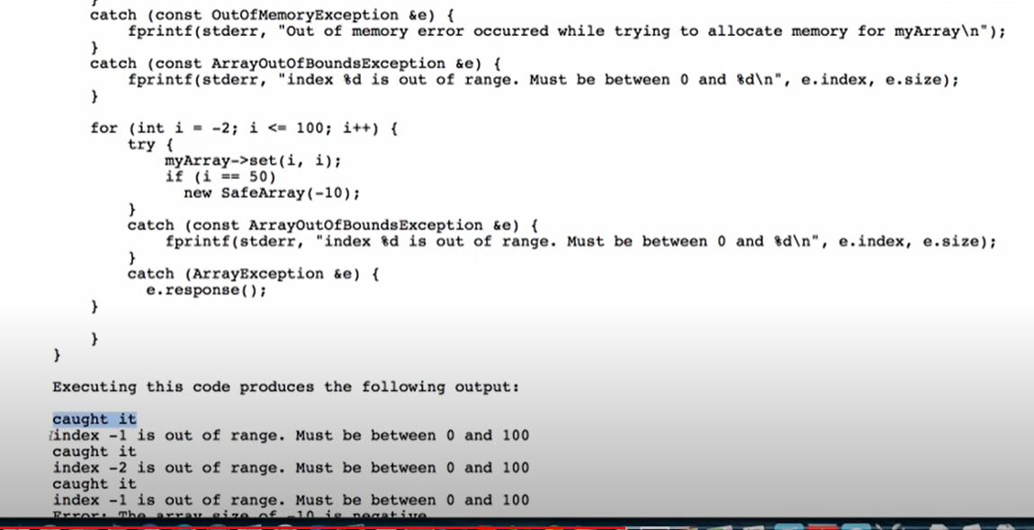

Slide 8
